Slide 1
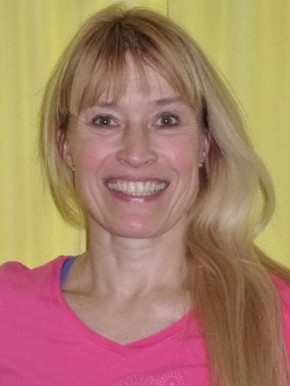
2015 Academic OASIS / IAABR – MIAMI International Multidisciplinary Academic Conference Miami, Florida, USA 3-5 January 2016 Welcome Note Dr Ursula Schinzel +352.621.322.543 ursula_schinzel@yahoo.com ursula-schinzel.com https://www.youtube.com/watch?v=YEHducaQQ4M
Notes:
This "Deco" border was drawn on the Slide master using PowerPoint's Rectangle and Line tools. A smaller version was placed on the Notes Master by selecting all of the elements (using Select All from the Edit menu), deselecting the unwanted elements such as the Title (holding down the Shift key and clicking on the unwanted elements), and then using Paste as Picture from the Edit menu to place the border on the Notes Master. After pasting as a picture, we used the resize handles (with Shift to maintain the proportions) to reduce it to the size you see.
Be sure to delete this word processing box before using this template for your own presentation.

